Slide 1
National Eclipse Project Presentation 2: Payloads
Alan Davis

Slide 2
Objectives
A Payload shall record video of the Moon’s shadow on the Earth
A Payload shall record pictures of the Moon’s shadow on the Earth
Payloads shall be able to track where the Balloon is located
Both Image Payloads shall downlink the data to the Ground Station

Slide 3
Requirements
The Balloon must have a tracking payload that using Iridium
A Payload must be able to cut down the Balloon with a command

Slide 4
Video Payload
Alan Davis

Slide 5
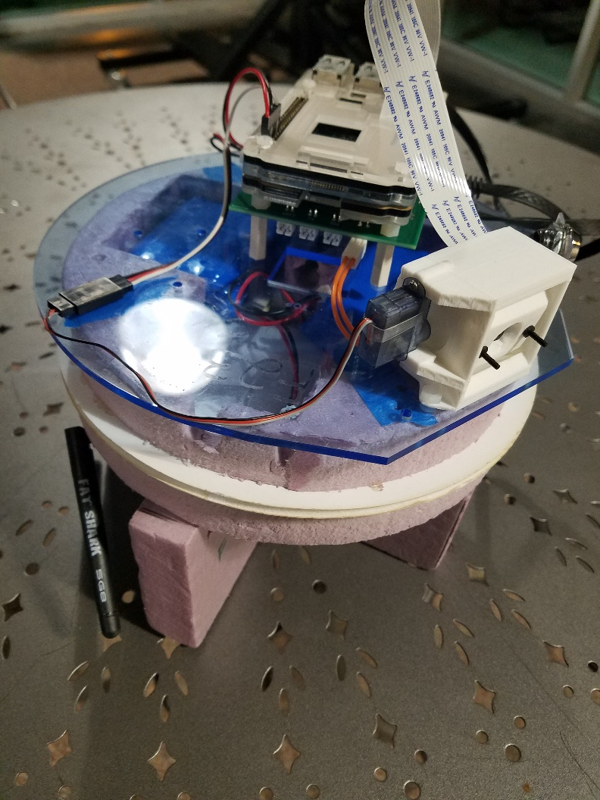
Video Payload: What was Provided
Montana State University
Using a Raspberry Pi
Pi-Camera

Slide 6
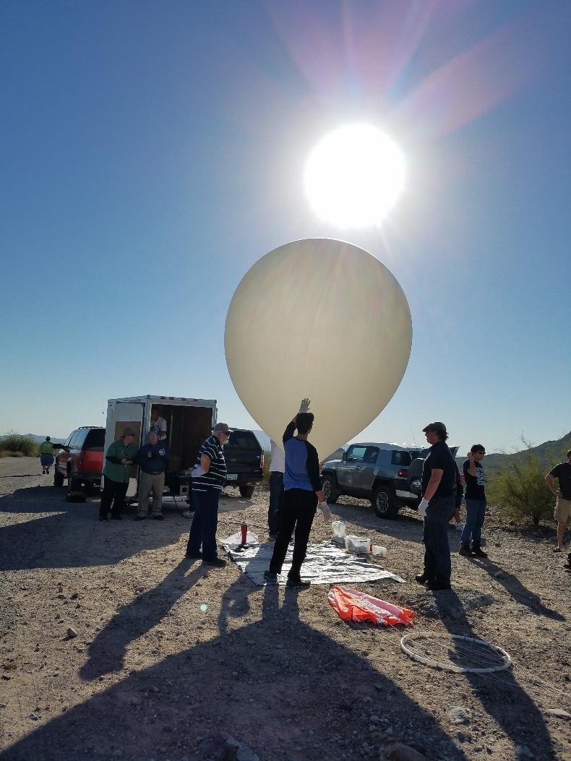
Video Payload: Tests
Lab Tests
Answer
March 12
April 15

Slide 7
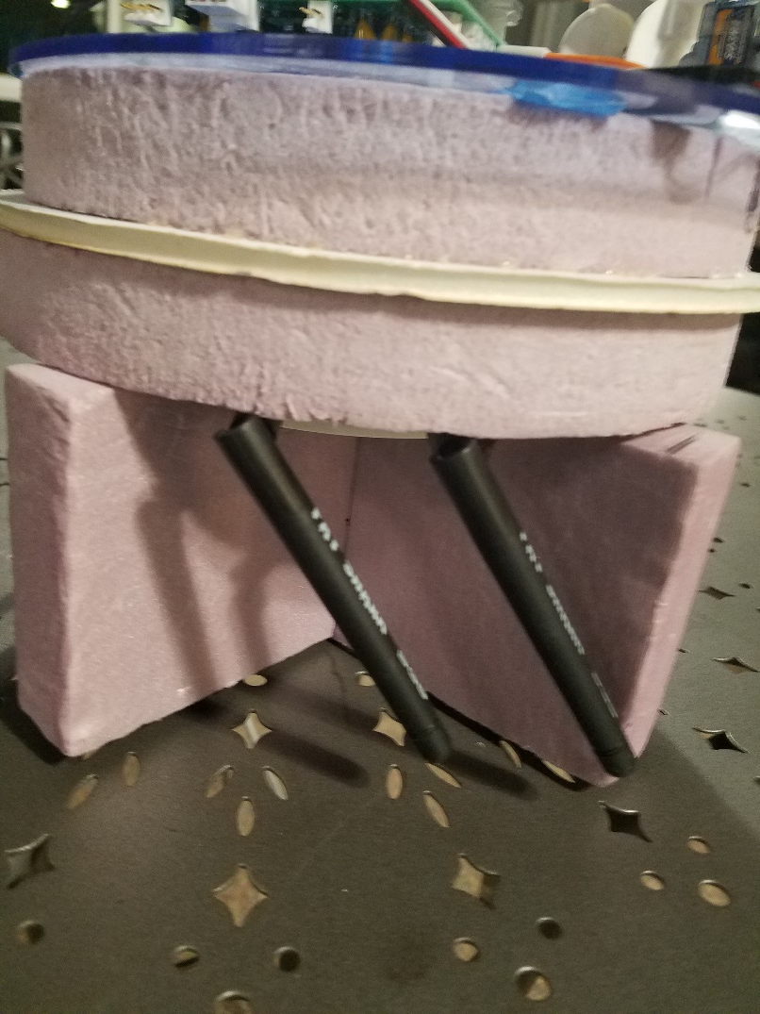
Video Payload: Problems
Thermal
Rotation Dampening
Antenna Sensitivity
Durability

Slide 8
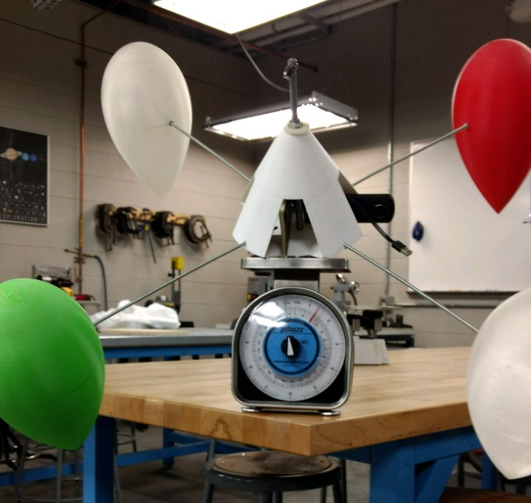
Video Payload: Improvements
New Casing
Using ERAU ASCEND Project’s Attitude Control
Use a different modem and antenna
Use the Image Payload Wi-Fi card

Slide 9

Video Payload: Results

Slide 10
Still Image Payload
Also Alan Davis

Slide 11
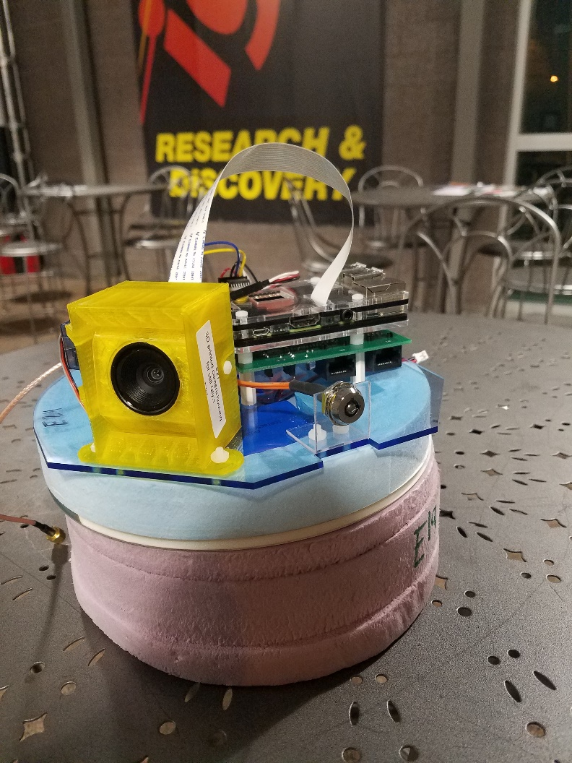
Picture Payload: What was Provided
RFD 900
Raspberry Pi
Pi-Camera

Slide 12
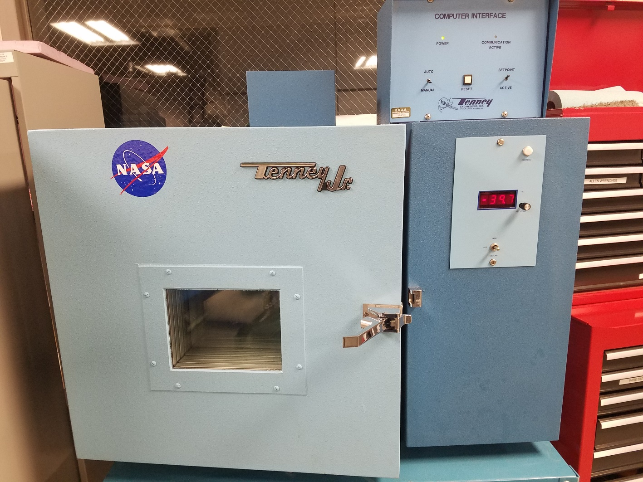
Picture Payload: Tests
Range
Pre-Launch

Slide 13
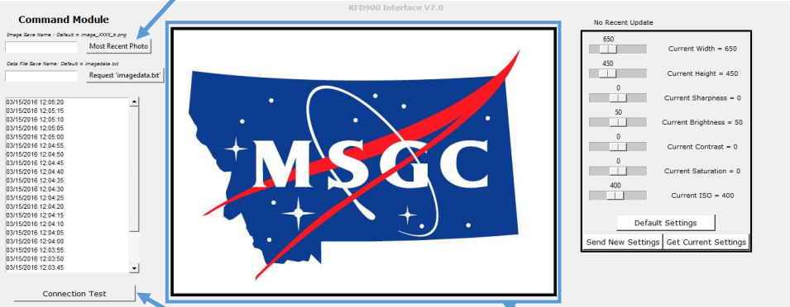
Picture Payload: Problems
Inconsistency
Ground Station Code

Slide 14
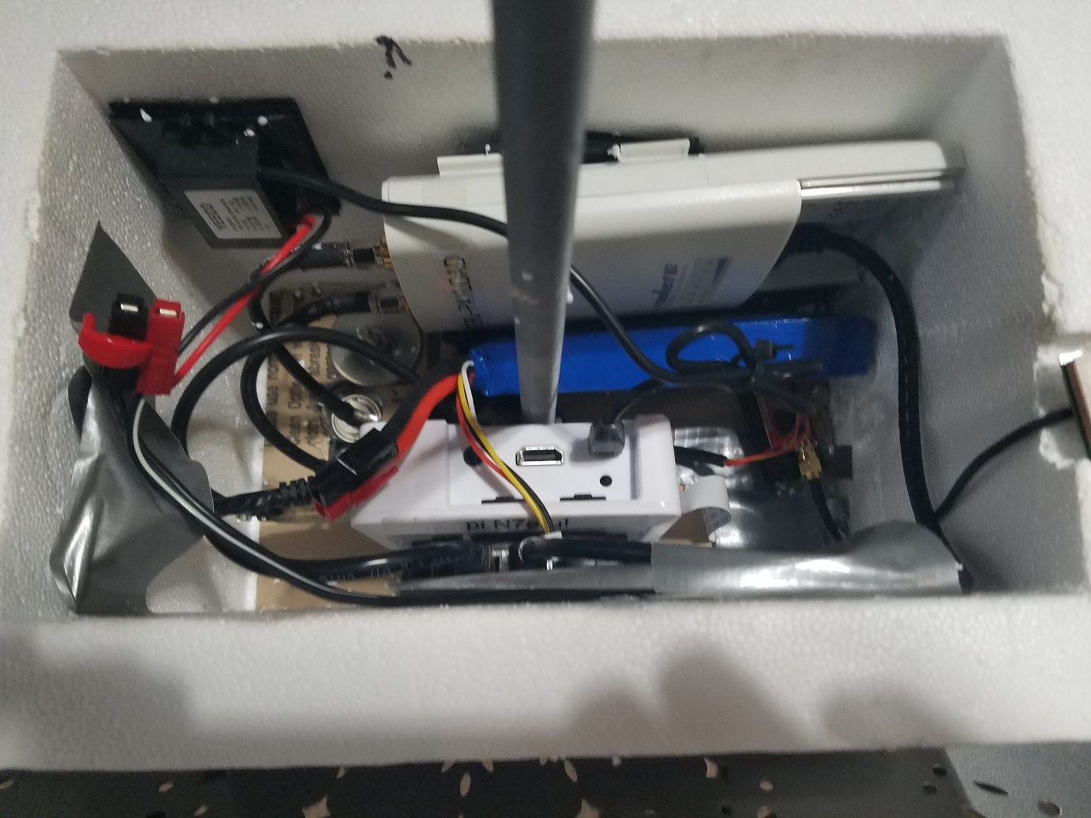
Picture Payload: Improvements
Rebuilt the Payload
2.4 GHz Modem
L-com antenna
CAMERA
Revamped the Code

Slide 15
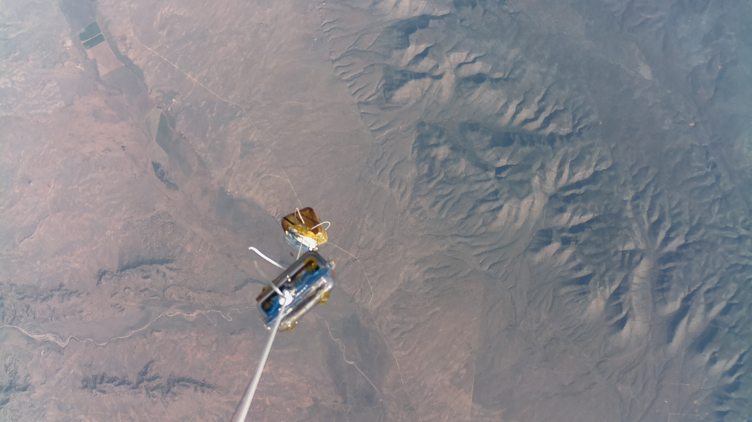
Picture Payload: Results
TO
Original
Current

Slide 16
Tracking
Guess who? Alan Davis

Slide 17

Tracking Payloads
NASA GPS & Iridium payload
3 ANSR APRS Trackers

Slide 18
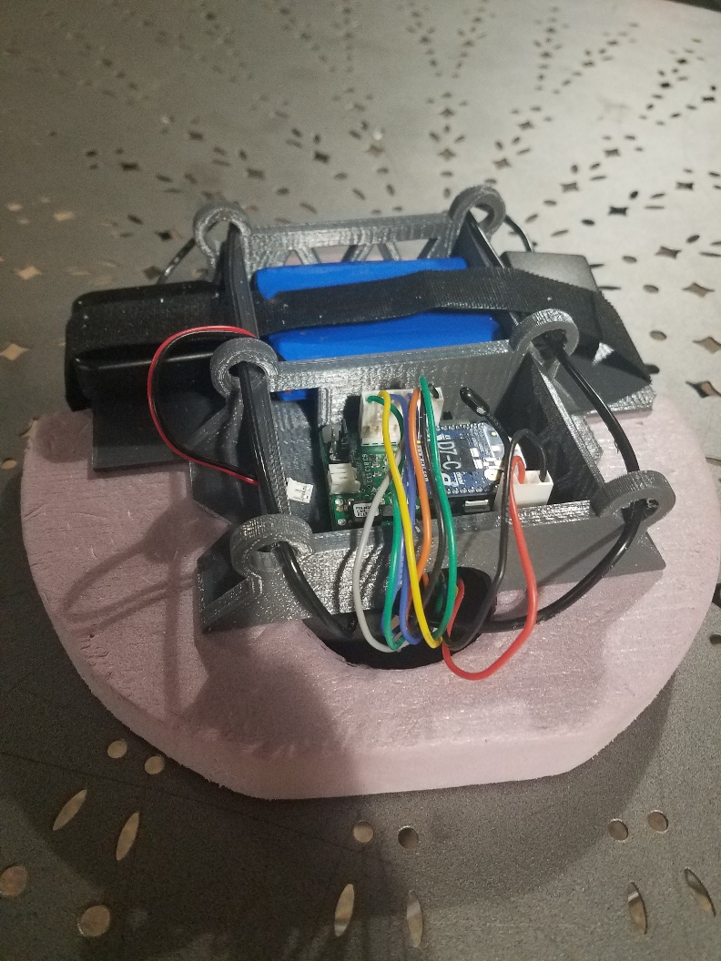
Iridium Tracking
Iridium satellite system
Orientation Restricted
Long Lag times
Depends on the position of satellites
Network overload

Slide 19
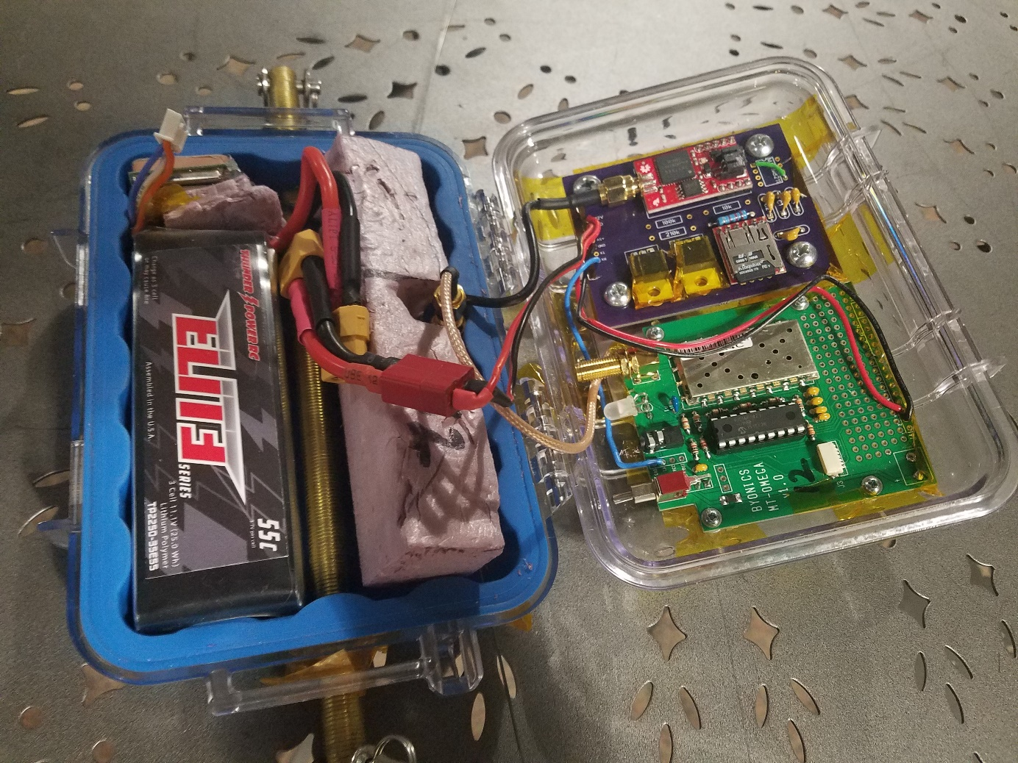
Tracking APRS
GPS Beacon
Transmitted through Venus board
Ham Radio signal down

Slide 20
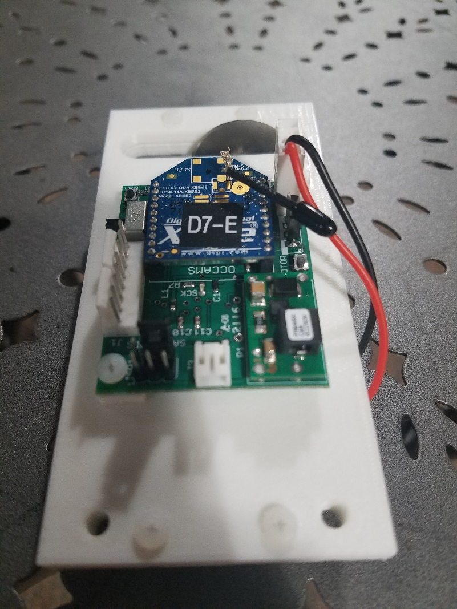
Cut Down Payload
Iridium Tracking Payload Receives an email
Signals the Cut-Down Payload to turn a Servo on
Cuts a rope sending the payloads down

Slide 21
References
Home. (n.d.). Retrieved April 06, 2017, from http://eclipse.montana.edu/
Iridium. (n.d.). Retrieved April 06, 2017, from http://www.remotesatellite.com/network- service-areas/iridium/

Slide 22
Acknowledgements
Prof. Jack Crabtree
Gene Swiech
Michael Fusco
Robert Velarde
Dr. Gary Yale
Jim Webber

Slide 23
QUESTIONS?
Alan Davis
Payload Specialist
(978) 325-2770
davisa54@my.erau.edu

